Slide 1
Data analysis and visualization
Instructor: Umme Ammarah

Slide 2
Natural language processing (NLP)
Introduction

Slide 3
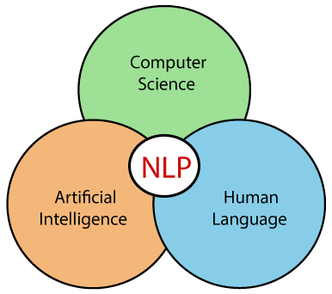
introduction
How to program computers to process and analyze large amounts of natural language data.
NLP gives machine the ability to understand human language better and to assist in language related tasks.
NLP uses statistical models, machine learning, deep learning to understand text.
Notes:
(NLP) is a branch of AI that aims at building computer systems that can understand natural language and respond in a natural language.
Human language is filled with ambiguities To "understand" written or spoken text in a natural language means to recognize the meaning, the intent and the sentiment of it.
These ambiguities in natural language make task of understanding natural language very hard. A number of NLP tasks are required to convert the text data into a meaningful form.

Slide 4
Applications
Notes:
https://datasciencedojo.com/blog/natural-language-processing-applications/#

Slide 5
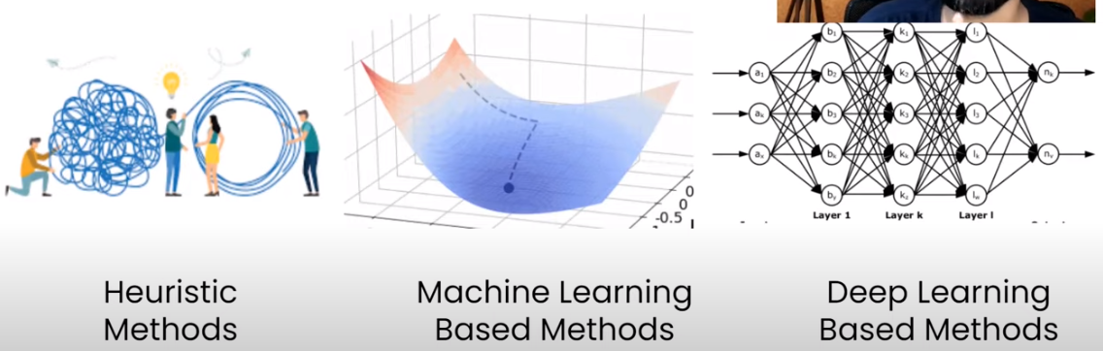
Approaches to nlp
Notes:
Heuristics, or "rules of thumb," are problem-solving methods that are based on practical experience and knowledge. trial and error, guesswork, the process of elimination, historical data analysis.

Slide 6
Useful python libraries for NLP
NLTK
SpaCy
TextBlob
Gensim
PolyGlot
Notes:
Text tokenization, part of speech tagging, stemming, lemmatization, named entity extraction, segmentation, classification, semantic reasoning.
Gensim is an open-source library for unsupervised topic modeling, document indexing, retrieval by similarity, and other natural language processing functionalities
PolyGlot: text analysis, text mining, sentiment analysis, polarity analysis, etc.

Slide 7
Terminologies
Document: collection of many words.
Vocabulary: set of unique words in a document.
Token: basic unit of discrete data. It often refers to a single word or a punctuation mark.
Corpus: collection of documents.
Context : Context of a word/token is the words/tokens that surround it on left and right in the document.
Vector Embedding: Vector based numerical representations of text.
Notes:
E.g., word2vec or GLoVE are unsupervised methods based on corpus statistics. Frameworks like tensorflow and keras support “Embedding layers”.
Text corpora is the plural form of text corpus . Text corpora are large and structured
collection of texts or textual data, usually consisting of bodies of written or spoken text,
often stored in electronic form

Slide 8
NLP pipeline
Data Acquisition
Text Preparation/Preprocessing
Feature Engineering
Modelling

Slide 9
Text preparation
Cleaning
Html tags cleaning
Removing emojis
Removing Special Characters
Spelling checker
Basic Preprocessing
Tokenization (sentence or word)
Stop word cleaning
Stemming/Lemmatization
Lower case conversion
Language detection
Advance Preprocessing
POS tagging
Parsing
coreference resolution
Notes:
TextBlog library to correct spellings
Stemming involves removing the suffixes from words to create a stem,
lemmatization involves mapping words to their root form based on their part of speech. The goal of stemming or lemmatization is to reduce the variability in the text data and improve the accuracy of downstream tasks.

Slide 10
Important Reminders for Preprocessing
Not all steps are necessary
These steps are NOT sequential
These steps are task-dependent
Notes:
Goals
Text Normalization
Text Tokenization
Text Enrichment/Annotation

Slide 11
Basic Preprocessing
Tokenization (sentence or word): Split the text into individual words or tokens.
Stop word removal:Remove common and uninformative words (e.g., "the," "and") that typically do not carry much meaning.
Normalization: Convert text to lowercase to ensure consistency in word representation.
Notes:
Stop word removal: Unlikely to improve machine learning prediction quality
Remove to reduce size of data
Punctuation also causes problems – basic approach is to remove everything that isn’t a,b,…,z
Sometimes punctuation is meaningful
• Twitter: @apple is a message to Apple, #apple is about Apple
• Web addresses: www.website.com/somepage.html
• Should tailor approach to the specific problem

Slide 12
Basic Preprocessing
Stemming/Lemmatization: Reduce words to their base or root form to reduce vocabulary size
Do we need to draw a distinction between the following words?
programming, programmer, programs, programed
Could all be represented by a common stem, program
Algorithmic process of performing this reduction is called stemming
Build a database of words | Rule-based algorithm “Porter Stemmer” | Machine learning
build a database of words and their stems Pro: handles exceptions Con: won’t handle new words, bad for the Internet! | removing the suffixes from words to reduce them to their base form,e.g. if word ends in “ed”, “ing”, or “ly”, remove it • Pro: handles new/unknown words well • Con: many exceptions, misses words like child and children (but would get other plurals: dog and dogs) | train algorithms to recognize the roots of words
Notes:
Reduce the variability in the text data and improve the accuracy of downstream tasks

Slide 13
Basic Preprocessing
Stemming vs Lemmatization
Stemming | Lemmatization
Stemming involves removing the suffixes from words to reduce them to their base form, often leading to incorrect meanings and spelling. | Lemmatization considers the context and converts the word to its meaningful base form, which is called Lemma.
"jumping" would be stemmed to "jump" stemming the word ‘Caring‘ would return ‘Car‘. | Lemmatizing the word ‘Caring‘ would return ‘Care‘.
Stemming is used in case of large dataset where performance is an issue. | Lemmatization is computationally expensive since it involves look-up tables
Notes:
Lemmatization and Stemming are the foundation of derived (inflected) words and hence the only difference between lemma and stem is that lemma is an actual word whereas, the stem may not be an actual language word.
Q. Which is better lemmatization or stemming?
A. The choice depends on the specific use case. Lemmatization produces a linguistically valid word while stemming is faster but may generate non-words.
Q. Why is stemming faster than lemmatization?
A. Stemming chops off word endings without considering linguistic context, making it computationally faster. Lemmatization analyzes word forms to determine the base or dictionary form, which takes more processing time.
Q. What is the application of stemming and lemmatization?
A. Stemming and lemmatization are used in natural language processing tasks such as information retrieval, text mining, sentiment analysis, and search engines to reduce words to their base or root forms for better analysis and understanding.

Slide 14
Advance preprocessing
Part of speech (POS) recognition
“Today is a beautiful day.”
Today | is | a | beautiful | day
Noun | Verb | Article | Adjective | Noun

Slide 15
Feature engineering
Converting words and sentences into numeric vectors for use with computational algorithms.
The process of representing a token/a sentence as a numerical vector is called ‘Embedding’,
Notes:
Example of reviews (no. of +ive words, -ive words, neutral words)

Slide 16
Properties for embedding
It should uniquely identify a word.
Arithmetic operations should be possible on these representations.
Tasks like computing word similarities and relationships should be easy.
Should capture the morphological, syntactic and semantic similarity among words.
It should be easy to map from word to its embedding and vice versa.
Notes:
Related words should appear closer in Eudlidean space than the unrelated words.
Morphological analysis (Part of Speech tagging).
The task of morphological analysis is to automatically determine which category each word in the text belongs to
semantic analysis is the process of drawing meaning from text

Slide 17
Prominent Techniques of embedding
One Hot Encoding
Bag of Words (BoW)
Term Frequency-Inverse Document Frequency (TF-IDF)
Word2Vec
GloVe
Fast Text
Transformers

Slide 18
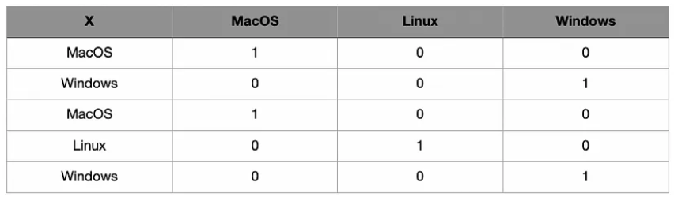
One hot encoding
Every word is represented as a unique ‘One-Hot’ binary vector of 0s and 1s.
For every unique word in the vocabulary, the vector contains a single 1 and rest all values are 0s, the position of 1 in the vector uniquely identifies a word.
Notes:
a vector is created in the size of the total number of unique words.
It is generally used in situations where there is not much verbal data diversity and there is no need to represent the semantic and statistical relationships between the data.

Slide 19
Bag of words (BoW)
A text (such as a sentence or a document) is represented as the bag (multiset) of its words, disregarding grammar and even word order but keeping multiplicity.
It involves two things:
Vocabulary of known words
Measure of the presence of known words
Notes:
The bag of words model is a technique used in natural language processing (NLP) to represent text data as a set of numerical features.

Slide 20
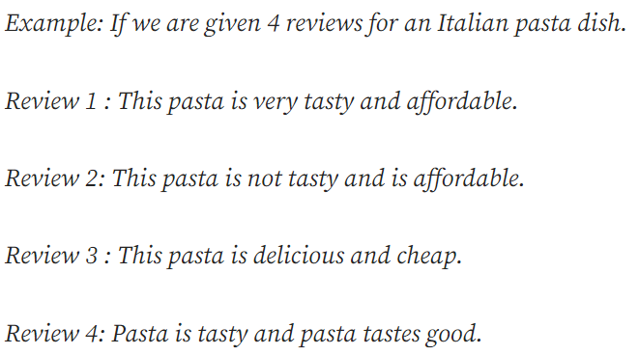
Example
If we count the number of unique words in all the four reviews we will be getting a total of 12 unique words.
Vocabulary:
‘This’ , ‘pasta’, ‘is’, ‘very’, ‘tasty’, ‘and’, ‘affordable’, ‘not’, ‘delicious’, ‘cheap’, ‘tastes’, ‘good’
Review 4:
Notes:
1) This step revolves around constructing a document corpus which consists of all the unique words in the whole of the text present in the data provided.
he CountVectorize Sparse Matrix

Slide 21
BOW
After converting the documents into such vectors we can compare different sentences and calculate the Euclidean distance between them so as to check if two sentences are similar or not. If there would be no common words distance would be much larger and vice-versa.
BOW doesn’t work very well when there are small changes in the terminology we are using as here we have sentences with similar meaning but with just different words.
BOW ignores word order
Notes:
This results in a vector with lots of zero scores called a sparse vector or sparse representation.
Sparse vectors require more memory and computational resources when modeling and the vast number of positions or dimensions can make the modeling process very challenging for traditional algorithms.
“not pay the bill” vs “pay the bill”, where the order makes a big difference

Slide 22
text similarity metric in nlp
How the two text documents close to each other in terms of their context or meaning
Various text similarity metric
cosine similarity
Euclidean distance
Jaccard similarity

Slide 23
cosine similarity
Cosine similarity is one of the metric to measure the text-similarity between two documents irrespective of their size in Natural language Processing.
The Cosine similarity of two documents range from 0 to 1
Two vectors have the same orientation if Cosine similarity score is 1.
The value closer to 0 indicates that the two documents have less similarity.

Slide 24
Example
Cosine Similarity between doc_1 and doc_2 is 0.47
Notes:
https://studymachinelearning.com/cosine-similarity-text-similarity-metric/

Slide 25
Jaccard Similarity
Jaccard Similarity defined as an intersection of two documents divided by the union of that two documents that refer to the number of common words over a total number of words\
The Jaccard Similarity score is in a range of 0 to 1. If the two documents are identical, Jaccard Similarity is 1. The Jaccard similarity score is 0 if there are no common words between two documents.

Slide 26
Term Frequency-Inverse Document Frequency (TF-IDF)
TF-IDF is a numerical statistic that is intended to reflect how important a word is to a document in a collection or corpus.
The tf–idf value increases proportionally to the number of times a word appears in the document and is offset by the number of documents in the corpus that contain the word.
This concept includes:
Count the number of times each word appears in a document.
Calculate the frequency that each word appears in a document out of all the words in the document.

Slide 27
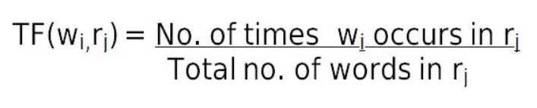
Term frequency
Term frequency (TF) shows how frequently an expression (term, word) occurs in a document.
Probability of finding a word in a document.
TF = (Number of repetitions of word in a document) / (# of words in a document)
Notes:
Term frequency indicates the significance of a particular term within the overall document.

Slide 28
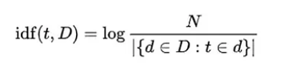
Inverse document frequency (IDF)
IDF is a measure of how much information the word provides, i.e., if it’s common or rare across all documents.
It is used to calculate the weight of rare words across all documents in the corpus.
It is the logarithmically scaled inverse fraction of the documents that contain the word.
IDF =Log[(# Number of documents) / (Number of documents containing the word)]
Notes:
The words that occur rarely in the corpus have a high IDF score.
(obtained by dividing the total number of documents by the number of documents containing the term, and then taking the logarithm of that quotient):
N = total documents / no of documents where t appears (normally +1 is added to avoid dividing by zero)

Slide 29
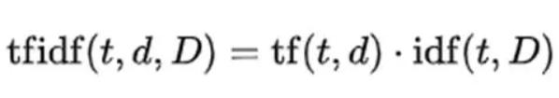
TF-IDF
TF-IDF gives larger values for less frequent words in the document corpus. TF-IDF value is high when both IDF and TF values are high i.e the word is rare in the whole documents but frequent in a document.
Notes:
BoW simply counts the occurrences of words in a document, whereas TF-IDF assigns a weight to each word based on its importance in the document and the entire corpus. TF-IDF overcomes the limitation of BoW, which is assigning equal importance to all words. By giving higher weight to rare words, TF-IDF can better capture the meaning of a document. However, both methods ignore word order and context, resulting in a loss of semantic information.

Slide 30
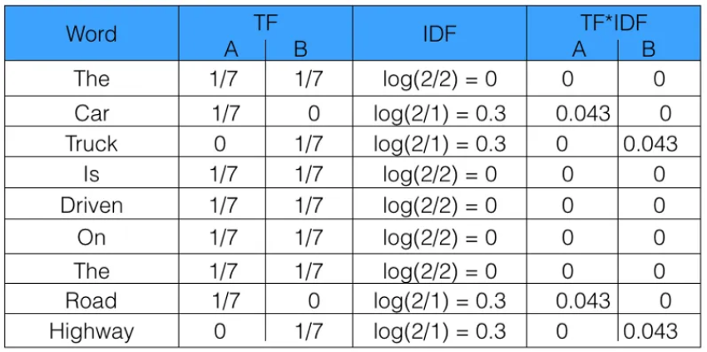
example
Sentence 1: The car is driven on the road.
Sentence 2: The truck is driven on the highway.
Notes:
Higher the TFIDF score, the rarer the term is and vice-versa.
The whole idea is to weigh down the frequent terms while scaling up the rare ones.
We have IDF to help remove common words like “the” or “is” that would, otherwise, have a high term frequency but are not that important

Slide 31
Example:
Notes:
https://dataaspirant.com/tf-idf-term-frequency-inverse-document-frequency/

Slide 32
cosine similarity
Tf-idf : cosine similarity between doc_1 and doc_2 is 0.32.

